Slide 1
MongoDB -
Configure MongoDB with Kerberos Authentication:
Ayush Tripathi and Krishangi Goswami

Slide 2
What is Kerberos Authorization?
It is an authentication protocol for clients/server applications. It uses tickets to allow nodes communicating over a non-secure network to prove their identity to one another in a secure manner.
With Kerberos, the client must be verified through a trusted third party which here is Key Distribution Centre (KDC).
KDC has two components- Authenticating Centre & Ticket Granting Centre.

Slide 3
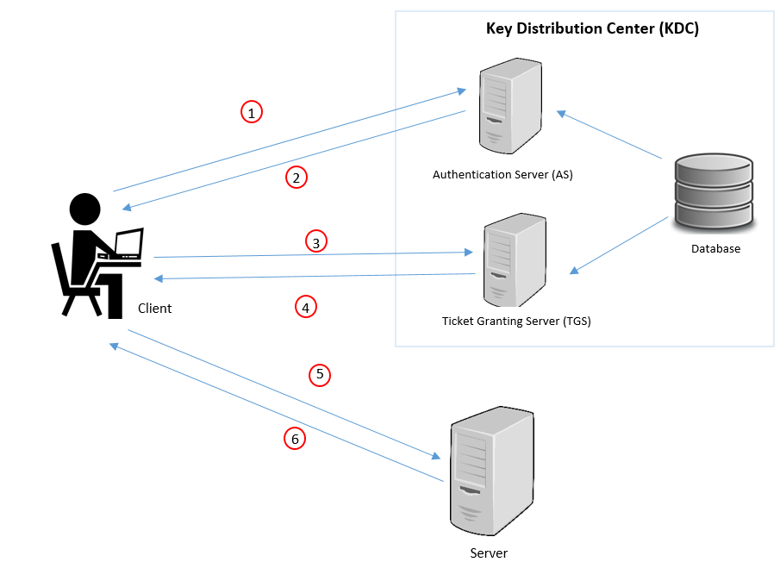
Main Components of Kerberos
Key Distribution Center
Authentication Server
Ticket Granting Server
Server
Client

Slide 4
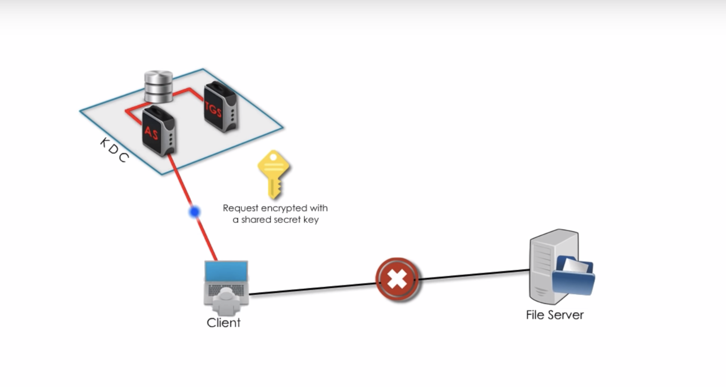
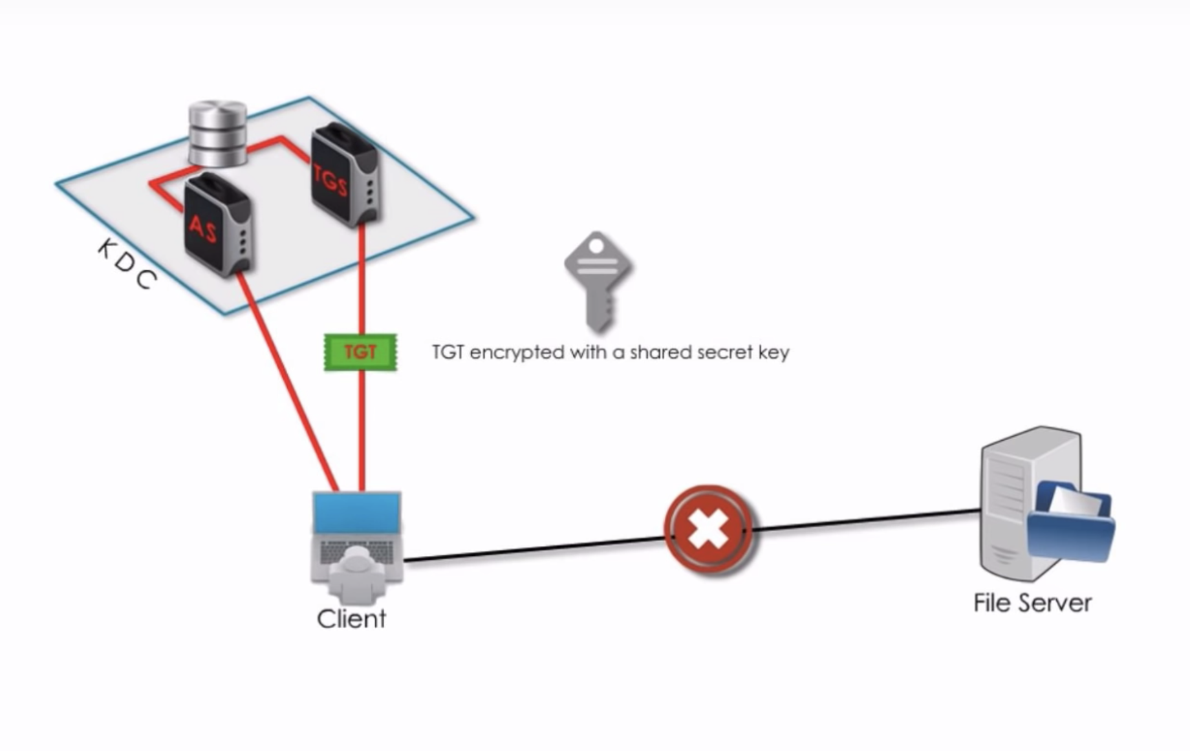
Kerberos- Contd.

Slide 5
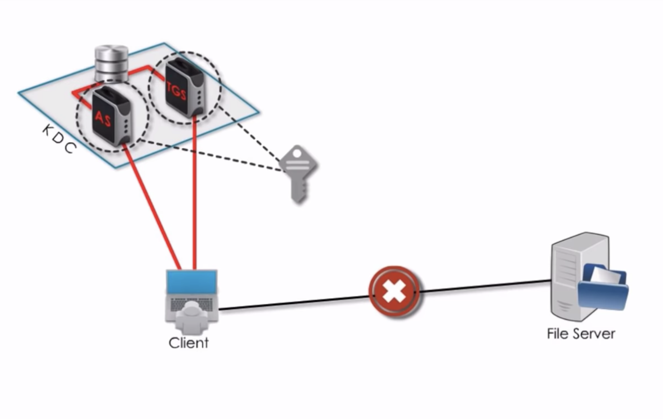
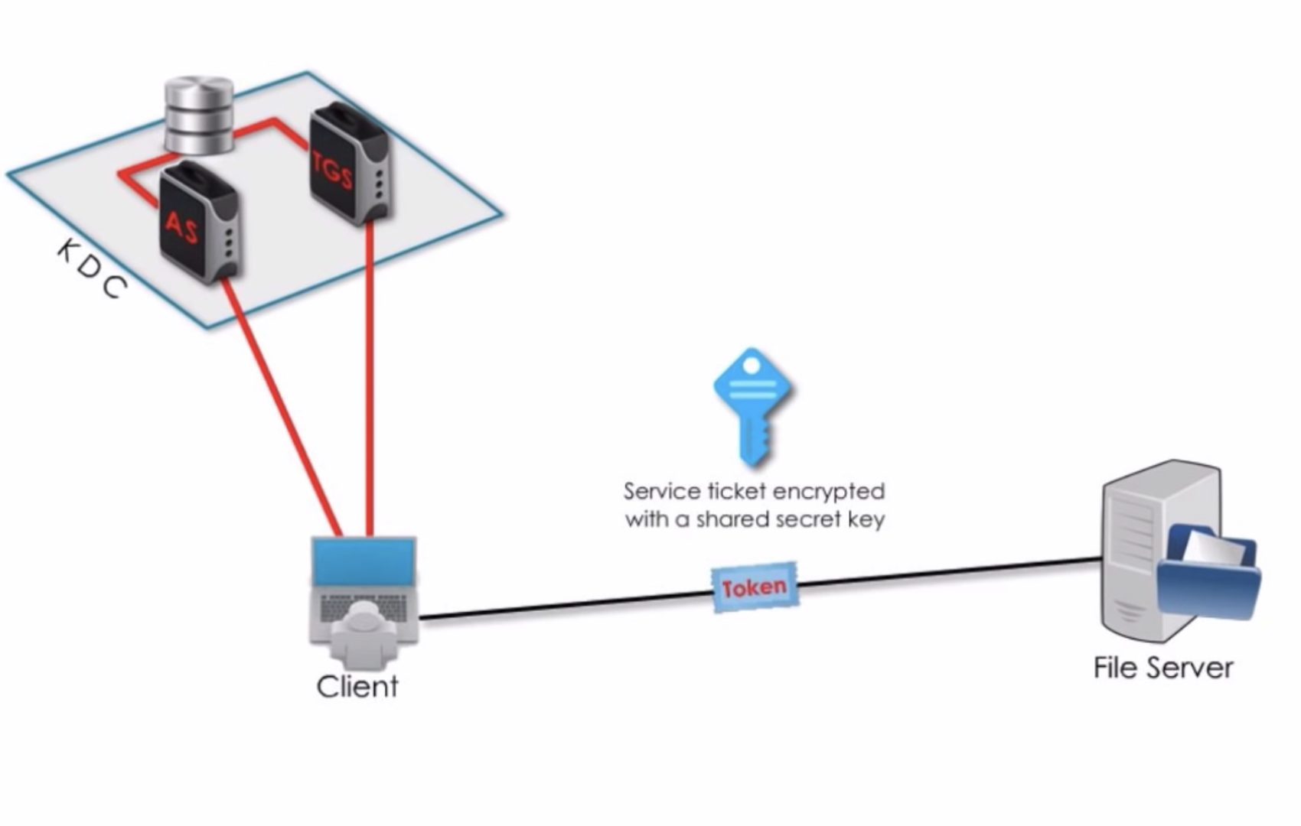
Kerberos- Contd.

Slide 6
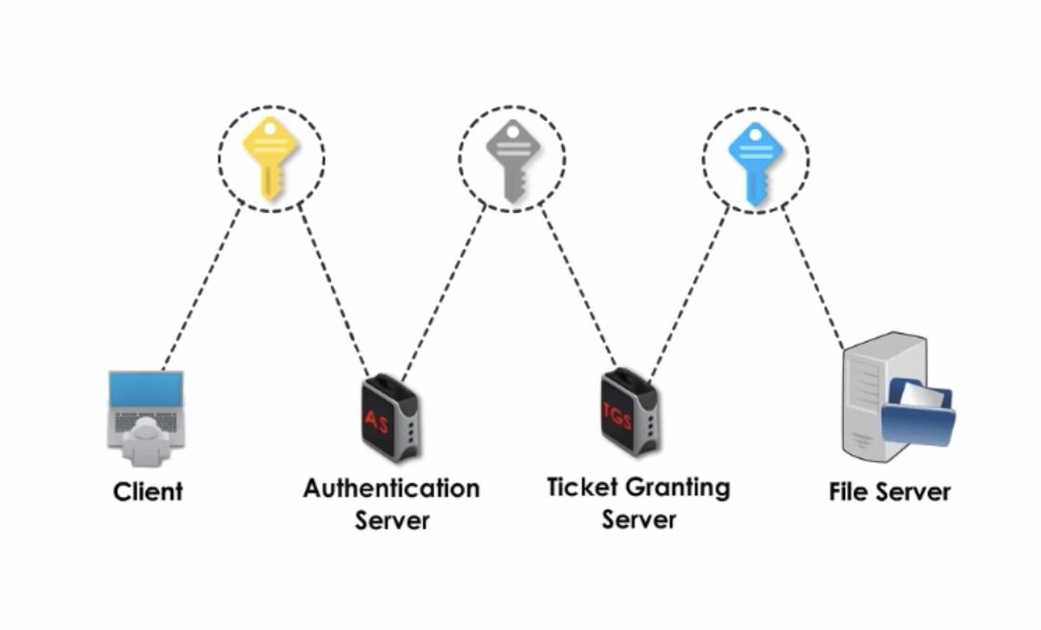
Kerberos- Contd.

